Slide 1

The Alabama Department of Early Childhood Education
ALABAMA TRANSITION GUIDANCE REVISION
Developing a cohesive and comprehensive system of high quality early learning and care.
Notes:
Alabama is implementing our nationally-recognized First Class Pre-K model as a bridge to develop and expand a birth to 8 continuum to create a vertical alignment spanning Pre-K to 3rd grade and birth to age 3. ally
First Class Pre-K
First Teacher Home Visiting
Children’s Policy Councils
Children First Trust Fund
Head Start Collaboration
Child Care Quality Coaching
Parent Engagement
P-3
Every program and project has a rigorous evaluation and research component

Slide 4
Your system…ANY system is perfectly designed to produce the results you are obtaining. (Adapted from Carr, 2008)

Slide 5
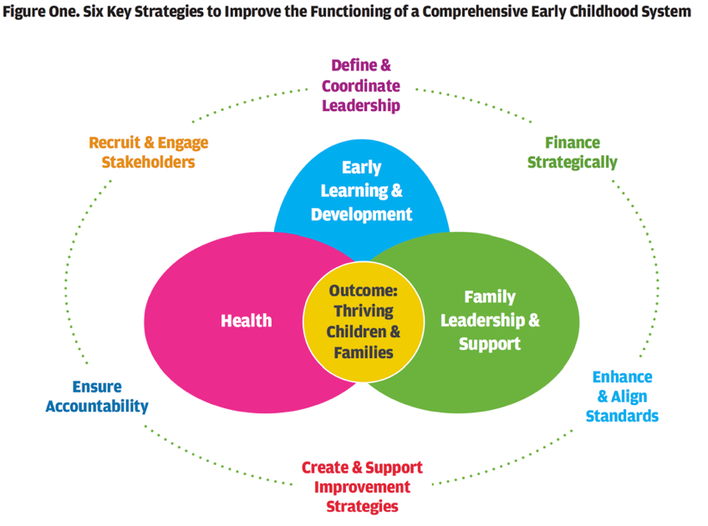
WHAT WE THINK THE SYSTEM LOOKS LIKE

Slide 6
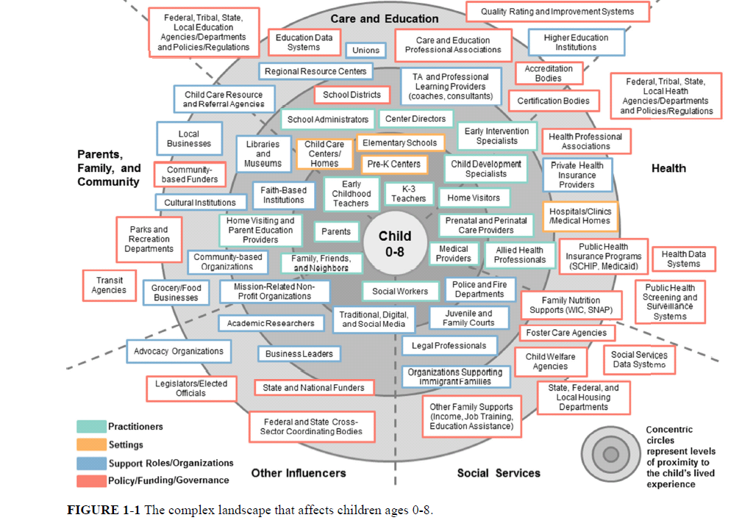
WHAT THE SYSTEM ACTUALLY LOOKS LIKE
Notes:
“Messy Map” of stakeholders FROM IOM REPORT
Many players.

Slide 7
Notes:
“.

Slide 8
Education and Care
Parents, Families, Communities
Health
Thriving children and families
Other Influencers
Social Services
Notes:
“.

Slide 9
Education and Care
Parents, Families, Communities
Health
Thriving children and families
Other Influencers
Social Services
Notes:
“.

Slide 10
Education and Care
Parents, Families, Communities
Health
Thriving children and families
Other Influencers
Social Services
Notes:
“.

Slide 12
Guiding Principles
CONNECTIONS
COLLABORATION
COORDINATION
COHERENCE
COMPETENCIES
CONTINUOUS IMPROVEMENT

Slide 13
What does best practice look like for:
Child
Family
Practitioners
Program/School Leaders
State and District Leaders

Slide 14
Guiding Questions
How is your programs/school/district supporting transitions?
Who is engaged in transition planning in your programs/schools/districts? Is there a “point person” for transitions in your program?
Do you have written guidance on transitions for families, practitioners, leaders?
What questions are asked on enrollment forms about children’s previous educational experiences?

Slide 15
Guiding Questions
What are the opportunities for cross-sector learning (i.e., bringing teachers and leaders from early learning programs and elementary schools together)?
How can schools find out about programs that typically feed into their kindergarten classrooms?
Are there agreements to share data between the district and early childhood
programs?

